Slide 1

Body Fat Project
Group 8
Xinyue Wang
Chenhao Fang
Milica Cvetkovic

Slide 2
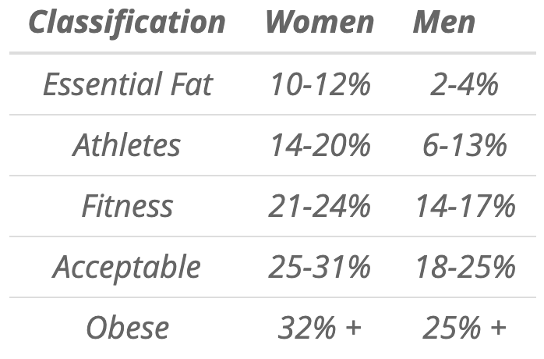
Background
The body fat is a significant indicator of human obesity.
It’s hard to measure. We need to find a effective way to calculate the bodyfat

Slide 3
Data Cleaning
We did unit conversion for the WEIGHT and HEIGHT features - from lbs to kg and from inches to cm.
By looking at the summary statistics, we noticed some unusual behaviors with BODYFAT, HEIGHT, and WEIGHT features.

Slide 4
Data Cleaning
BODYFAT
ffdsd
We used Siri equation to calculate body fat for IDNO 172 and 182
Body Fat = (495/Body Density)-450 is Siri equation
The calculation indicated wrong densities. By looking at the similar data points based on age, height, weight and measurements, which resulted in IDNO 45, we deduced that 182 density was a typo, and we changed it to 1.089. The new body fat was 4.54.
We did similar with 172, which resulted in new body fat approximately 7.064.

Slide 5
Data Cleaning
WEIGHT
Using ADIPOSITY feature, we calculated weight for IDNO 39 using the bmi formula.
IDNO | WEIGHT before | WEIGHT after
39 | 164.7221 | 132.6953

Slide 6
Data Cleaning
HEIGHT
Using ADIPOSITY feature, we calculated weight for IDNO 42 using the bmi formula.
IDNO | HEIGHT before | HEIGHT after
42 | 74.93 | 176.3408

Slide 7
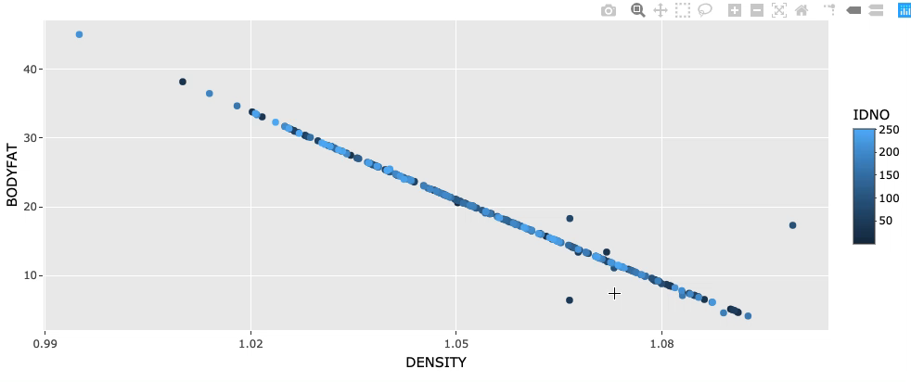
Data Cleaning
Visual Exploration
Using plotly interactive plots, we looked into DENSITY vs. BODYFAT. Further exploration of the outliers, led to conclusion that IDNO 48,96 and 216 were possible data errors.

Slide 8
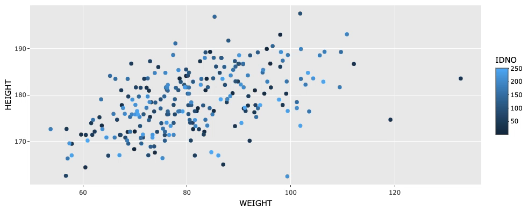
Data Cleaning
Visual Exploration
Using plotly interactive plots, we looked into WEIGHT vs. HEIGHT. Although, we already did some adjustments to IDNO 39, this point still seems like an outlier.

Slide 9
Data Cleaning
Summary of Changes Used to Build Models
IDNO | WEIGHT before | Changes | WEIGHT after
163 | 184.25 lbs | -20 | 164.25 lbs
221 | 153.25 lbs | +20 | 173.25 lbs
IDNO | HEIGHT before | Changes | HEIGHT after
42 | 74.93 cm | +100 | 174.93 cm
When we built the model, we deleted two data points with “IDNO” 172 and 182 according to Milica’s suggestion.
Before fitting the final model, we also deleted 39th data point since it is an outlier detected by the model.

Slide 10
Finding the Best Model
The Akaike information criterion (AIC)
What?
In plain words, AIC is a single number score that can be used to determine which of multiple models is most likely to be the best model for a given dataset.
How?
It estimates models relatively, meaning that AIC scores are only useful in comparison with other AIC scores for the same dataset. A lower AIC score is better.

Slide 11
Results
Final Model
FORMULA
R^2 is 0.7408181, adjusted R^2 is 0.7343921 which means more than 73% of variation of in body fat can be explained.
Rule of thumb:

Slide 12
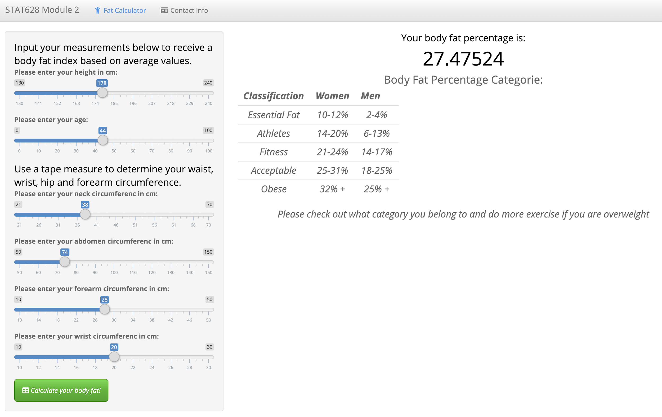
Results
Usage example:
We build a shiny app using this model:
Final Model

Slide 13
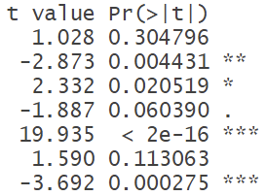
Results
Statistical Properties of Final Model
What is t value?
The t-statistic tells us about how far our estimated parameter is from a hypothesized 0 value. It is used for individual features.
What is Pr(>|t|)?
This tells us the probability of observing a value at least as extreme as the test statistics. If this probability is sufficiently low, we can reject the null hypothesis that this coefficient is 0
F-Statistic and F-test?
In addition to looking at whether individual features have a significant effect, we may also wonder whether at least one feature has a significant effect.

Slide 14
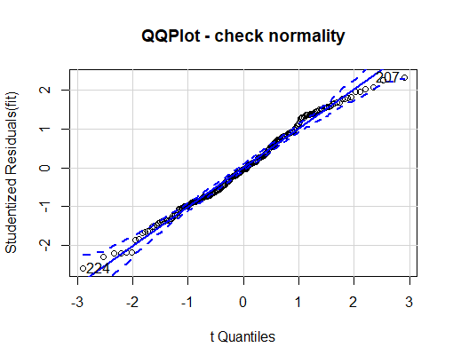
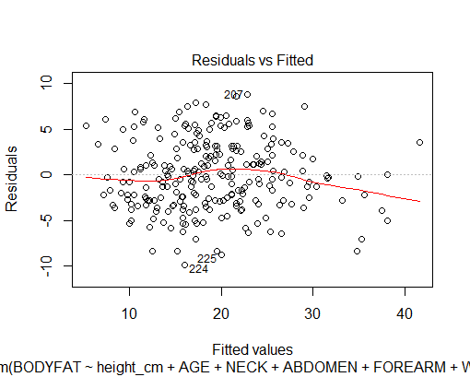
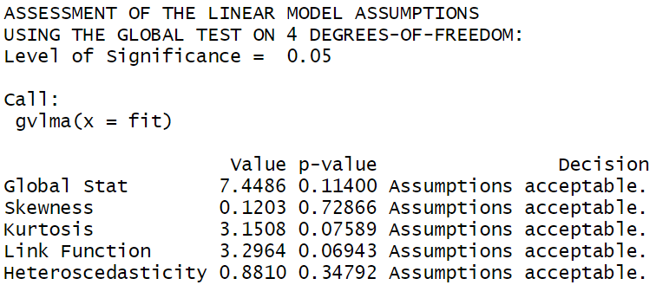
Model Diagnostics
We checked the global linear model assumptions first. Under 0.05 level of significance, all decisions are “Assumptions Acceptable”. We also used residual plot to further check the heteroscedasticity.
Then, we checked the normality. Although the tail is very slightly off the line, we can still believe that it doesn’t violate the normal assumption.

Slide 15
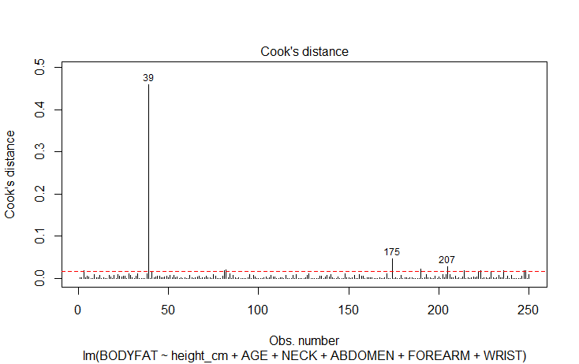
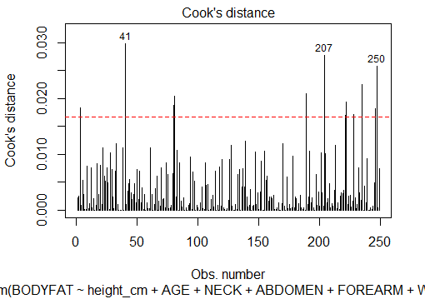
Model Diagnostics
Then, we checked the outliers. It’s very obvious from these two plots and the two plots in the next slide that the 39th data point is an outlier. And that’s why I decided to delete it before fitting the final model.
Cook’s distance with IDNO 39.
Cook’s distance without IDNO 39.

Slide 16
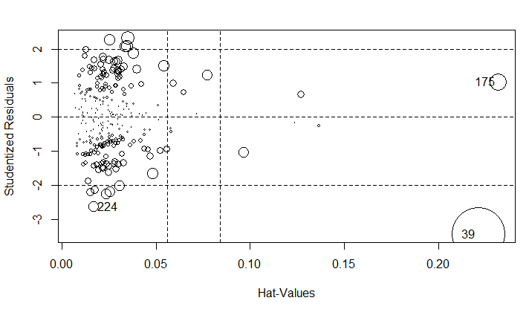
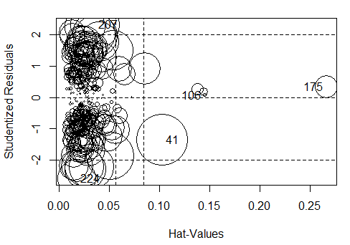
Model Diagnostics
There are also other suspicious points. But since the sample size is not large enough, I tend to keep them for now.
Influential plot with IDNO 39.
Influential plot without IDNO 39.

Slide 17
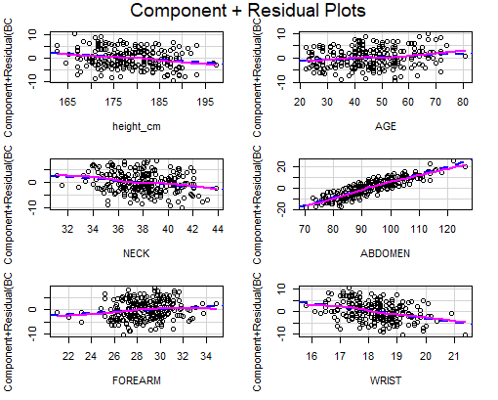
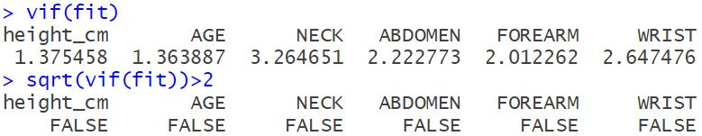

Model Diagnostics
Other checks - All good.
Linearity Between Variables and Body Fat
VIF results - Multicollinearity
Durbin-Watson Test - Independence of Errors

Slide 18
Strengths and Weaknesses
Final Model:
Strengths:
Simple and can be interpreted easily.
Reliable - it doesn’t violate any assumption of linear regression.
It can explain more than 73% of variation in body fat.
Weaknesses:
The adjusted R^2 of this model isn’t the largest among our candidates.

Slide 19
Thank you for your time!

